Slide 1

INTERNAL JOB PORTAL Dotnet batch
FINAL PROJECT
TEAM-1

Slide 2
TEAM MEMBERS:
Nandhitha K- ZS-INT-0177
Balamurugan M- ZS-INT-0187
Sachithanantham M-ZS-INT-0182
Santha Kumar C- ZS-INT-0202

Slide 3
ABOUT THE PROJECT
Internal job posting means advertising open job positions in the company itself to hire existing employees for open opportunities.
Internal Job Portal is an intranet MVC app using which managers can post new job requirements, and the employees can apply to posted jobs, if they are interested and match the skillset required by the job.

Slide 4
DISADVANTAGES OF THE CURRENT SYSTEM
The existing system takes extra effort and money to hire employees from outside.
It may increase attrition.
Onboarding process takes lot of time to integrate a new employee into the company and assign their role.
Employees doesn’t have internal knowledge about the work culture.

Slide 5
ADVANTAGES OF THE PROJECT
Internal job posting serves as a significant recruitment approach, yielding benefits in time and cost savings while also minimizing the need for external hiring efforts.
Attrition rate reduces within the organization.
Easier way to retain existing employees and giving them new job roles.
Portal also stores all the data in a database.
It also generate various reports which will be useful for HR ,recruiting manager and the employees.

Slide 6
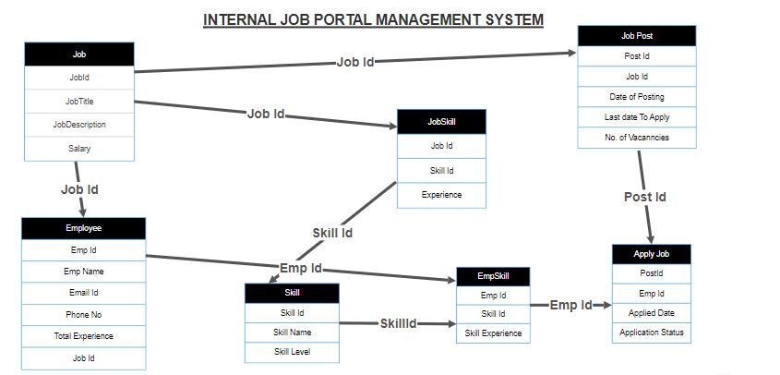
PROJECT STRUCTURE

Slide 7
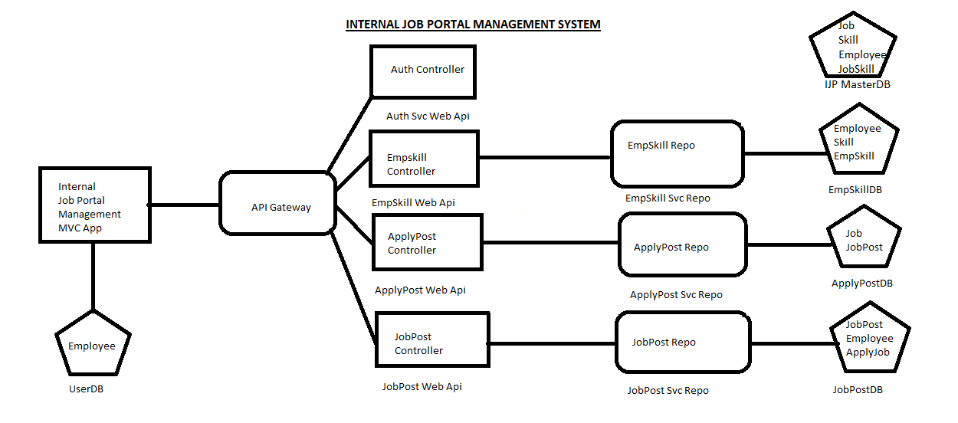
MICROSERVICE ARCHITECTURE

Slide 8
ADVANTAGES OF MICROSERVICE
Flexibility and Agility
Fault Isolation
Improved Maintainability
Technology Diversity
Enhanced Team Autonomy

Slide 9
PROJECT MODULES
EmpSkill Module
JobPost Module
ApplyJob Module

Slide 10
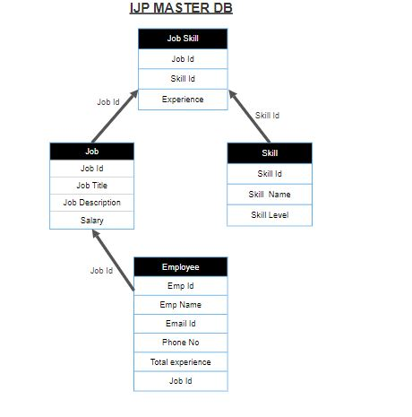
MASTER DataBase ER DIAGRAM

Slide 11
INTERNAL JOB PORTAL
The Internal Job Portal is an ASP.NET Core MVC App.
It is secured using Role based authentication.
It has the following controllers:
Home
EmpSkill
JobPost
ApplyJob

Slide 12
EMPSKILL DESCRIPTION
EmpSkill Microservice contains the following endpoints:
Add new Skill
Update Skill
Delete Skill
View by Emp Id
View by Skill Id
View all Emp Skills
View by Skill Id and Emp Id

Slide 13
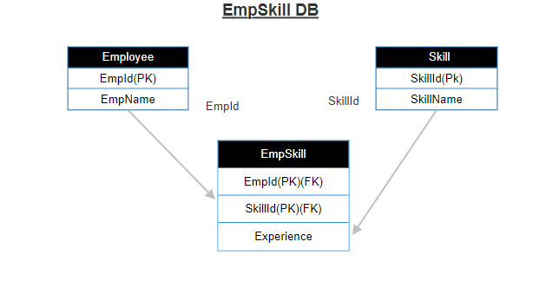
EMPSKILL DATABASE ER DIAGRAM

Slide 14
EMPSKILL CLASS LIBRARY
EmpSkill class library contains the following two folders:
Models
Repos
Model includes Model classes and Context class.
Repo includes EmpSkill interfaces and class implementing using
EntityFrameworkcore.

Slide 15
EMPSKILL WEB API
Web Api methods are used to perform operations on resource.
The endpoints used in EmpSkill Web Api are
GetAllEmpSkill
GetOne
GetBySkillId
GetByEmpId
Put
Post
Delete

Slide 16
JOBPOST DESCRIPTION
JobPost Microservice contains the following endpoints:
Add new job post
Update job post
Delete job post
View all job post
View by post id
View by last date
View by post date
View by job id
View by job detail

Slide 17
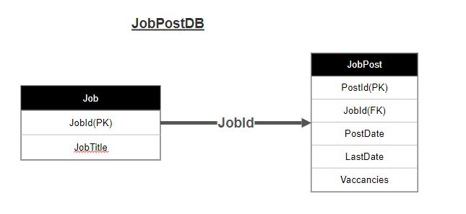
JOBPOST DataBase ER DIAGRAM

Slide 18
JOBPOST CLASS LIBRARY
JobPost class library contains the following two folders:
Models
Repos
Model includes Model classes and Context class.
Repo includes JobPost interfaces and class implementing using
EntityFrameworkcore..

Slide 19
JOBPOST WEB API
The endpoints used in JobPost Web Api are
GetAllJobPost
GetByJobId
GetByPostId
GetByPostDate
GetJobDetails
GetByLastDate
Put
Post
Delete

Slide 20
APPLYJOB DESCRIPTION
ApplyJob Microservice contains the following endpoints:
Add new apply job
Update applied job
Delete applied job
View all applications
View by status
View by applied date
View by emp id
View by post id
View by emp id and post id

Slide 21
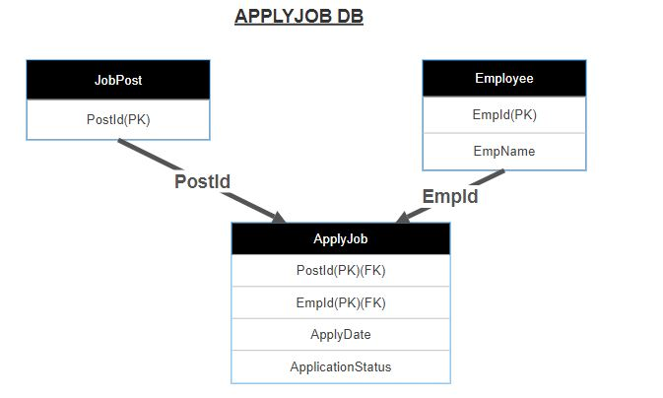
APPLYJOB DataBase ER DIAGRAM

Slide 22
APPLYJOB CLASS LIBRARY
ApplyJob class library contains the following two folders:
Models
Repos
Model includes Model classes and Context class.
Repo includes ApplyJob interfaces and class implementing using
EntityFrameworkcore..

Slide 23
APPLYJOB WEB API
The endpoints used in ApplyJob Web Api are
GetAll
GetByEmpId
GetByPostId
GetByAppliedDate
GetByStatus
GetApplyJob
Put
Post
Delete

Slide 24
AUTHENTICATION SERVICE
The authentication service simplifies access by offering a single endpoint. Upon receiving the secret key, this endpoint generates a JSON Web Token (JWT).
Each JWT includes two essential claims:
UserId
Role
This role plays a pivotal role in verifying access to controllers within other microservices.
Role includes:
Admin
Manager
Employee

Slide 25
API GATEWAY
An API gateway serves as a central hub for managing and controlling access to multiple backend services.
It functions as a reverse proxy, receive and forwards the API calls.
By aggregating various services, it efficiently processes the requests and delivers the expected outcomes back to the client.

Slide 26
THANK YOU!!

